Slide 1


MODERN AI
APPLICATIONS

Slide 2




APPLICATION 01
CHATBOTS MAKE
INFORMATION FEEL
INSTANT.
ASK.
They understand questions written in everyday language.
They can answer, guide, summarize, and hand off to a person.
ANSWER.
Common uses: customer support, learning, and internal help desks.
HAND OFF.

Slide 3



APPLICATION 02
SENTIMENT ANALYSIS
READS THE MOOD.
POSITIVE
NEUTRAL
NEGATIVE
“Works perfectly.”
“Arrived on Tuesday.”
“Too hard to use.”
Teams use it to spot customer satisfaction, complaints, and changing reactions. Example: grouping thousands of product reviews by overall feeling.
It turns written reactions into a simple emotional signal.

Slide 4





APPLICATION 03
DOCUMENT
CLASSIFICATION
SORTS THE FLOOD.
It assigns documents to useful categories automatically.
INVOICES
RESUMES
CONTRACTS
TICKETS
The result: less manual filing and faster search.

Slide 5



APPLICATION 04
RAG GIVES ANSWERS A
KNOWLEDGE BASE.
RAG means the model checks trusted documents before it answers.
RETRIEVE
ADD CONTEXT
GENERATE
Find relevant information in trusted documents.
Give that context to a language model.
Answer using the retrieved material.

Slide 6
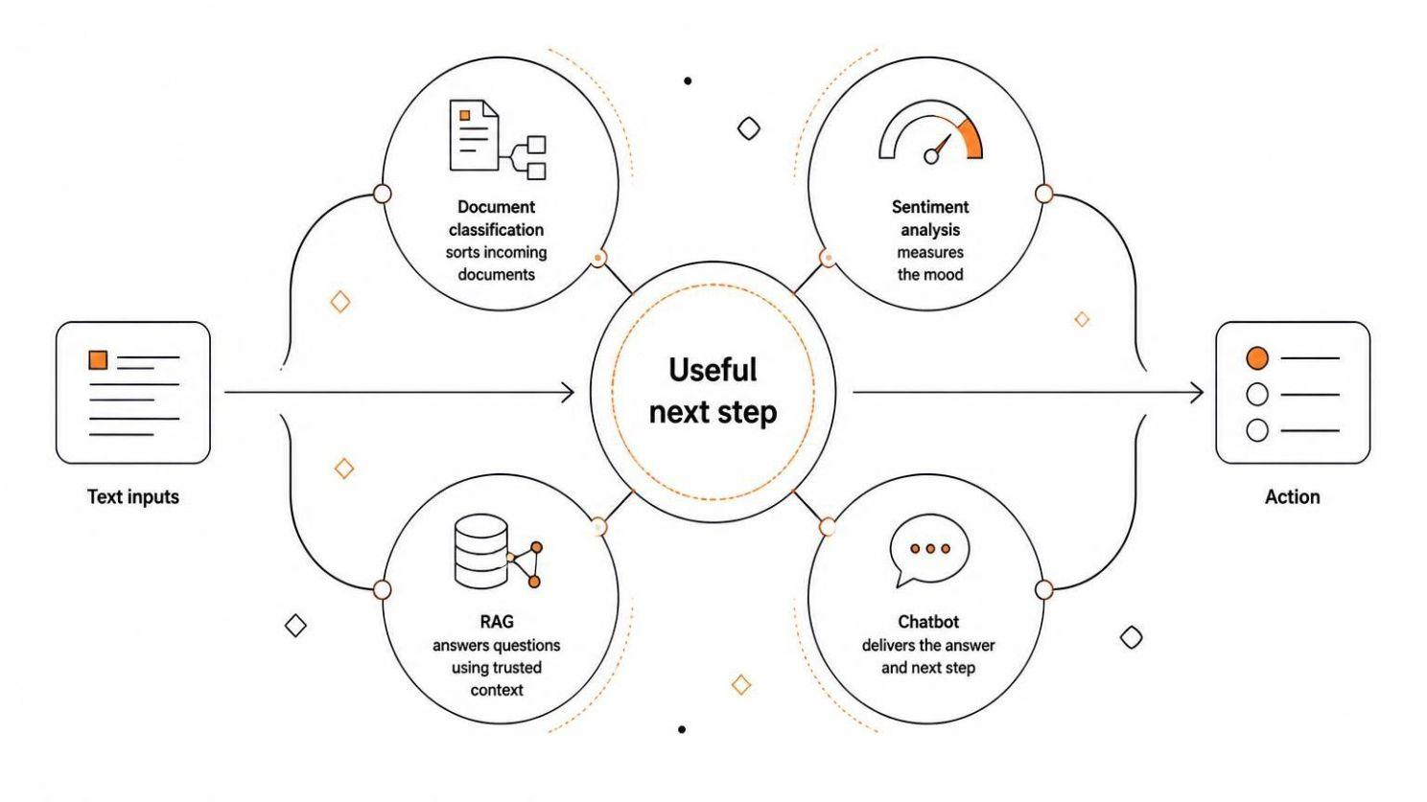
THE SYSTEM VIEW
TOGETHER, THEY TURN TEXT INTO ACTION.
Each tool handles one part of the journey, moving messy text toward a useful next step.

Slide 7

THANK YOU…..!

